Slide 1
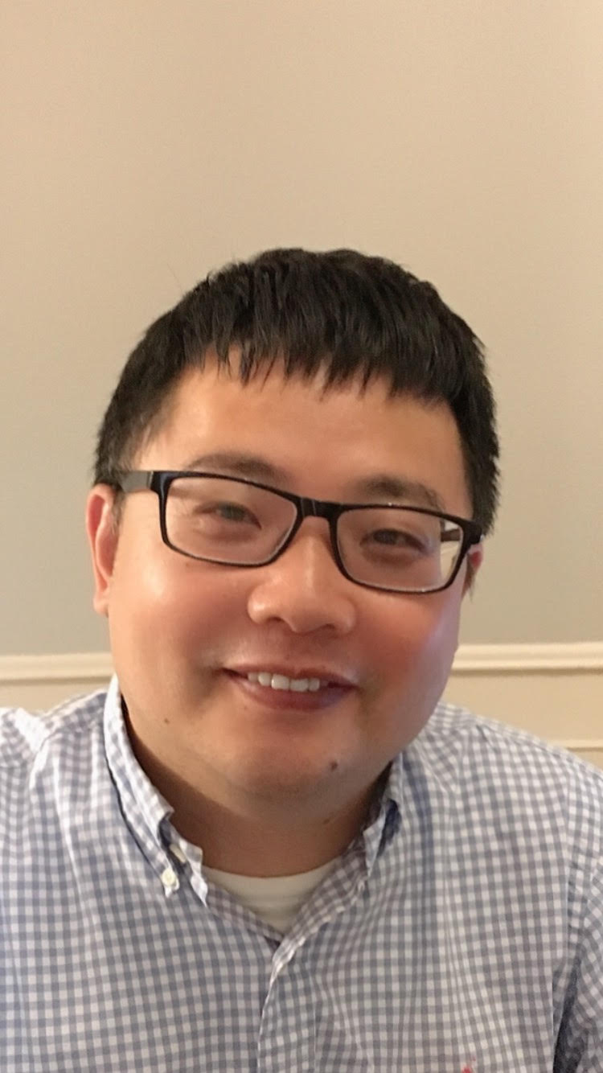
AI Applications for MCBU and CTC Projects
Chaoshun Hu
Chevron Energy Technology Company
Technical Computing
Subsurface Workflows Unit
Houston, Texas USA
Notes:
Good afternoon, Thanks Fan for the introduction. my Name is Chaoshun Hu, I am current a senior data scientist with a strong background in Geophysics.

Slide 2
Outlines
Artificial Learning Fracturing (ALF) Project for MCBU
Deep Learning Clustering (DLC) for DAS Microseismic Classification
Deep Reinforcement Learning(DRL) for RPE Field Development Plan Optimization
Notes:
Today I want to sharing what AI knowledge I learned thorough 3 different deep elaring and reinforcement learning project. The first one is ALF project for MCBU reservoir team; the 2nd one is deep learing clustering for DAS microseismic classification; my 3rd one is deep reinforcement learning for RPE field development plan optimization.

Slide 3
What I do in Chevron? Artificial Learning Fracturing Project for MCBU as a AI/ML SME, technical leader and primary developer collaboration: Mike Li, Baosheng Liang, Steve Yow…
(patented)
Notes:
The 1st project is ALF for MCUB. My job role is as a AI/ML SME, technical leader and primary developer

Slide 4
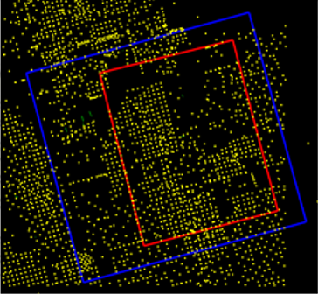
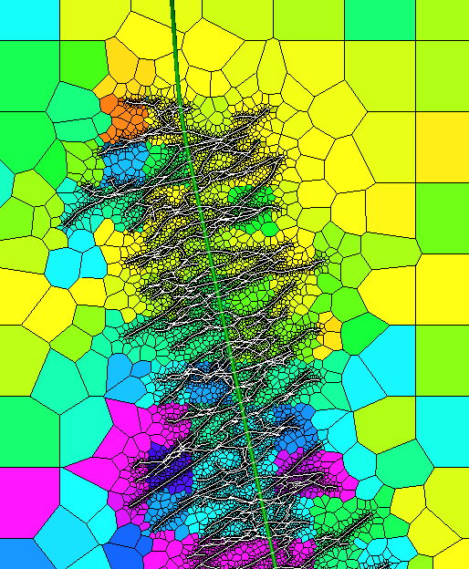
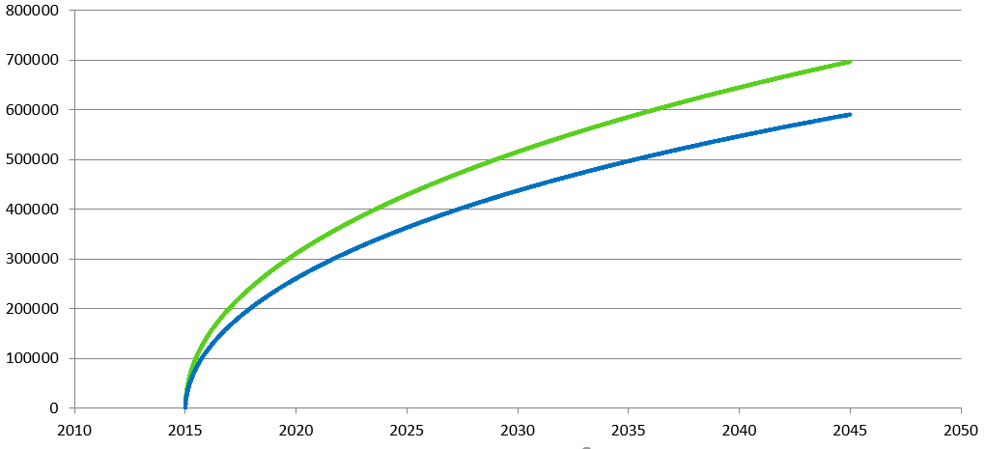
ALF Project
Earth Modeling
Hydraulic Fracturing
Production Performance
2D map view
2D map view
single well
AOI
multiple well
Pad
Current complex workflow
High OC requirement for repetitive effort
Time consuming
Suitable for strategic planning
Challenging for well performance lookback
Benefits of ALF
Minimum OC requirement to use
Much faster to generate results
Less accuracy than complex workflow
Suitable for well performance lookback
Notes:
Current simulation workflow is very complex and needs high OC requirement for repetitive effort. Very time consuming. Therefore it is very challenging for well performance lookback.
The objective of ALF include minimum OC requirement to use and it needs minutes to use AI to do prediction instead of weeks or months manual operation in Petrel.

Slide 5

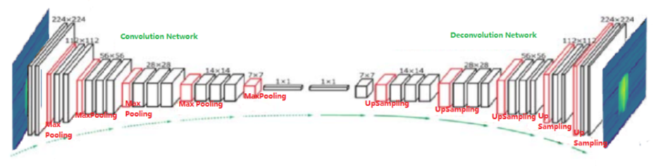

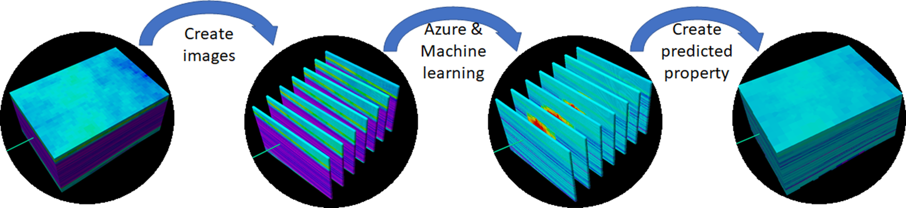
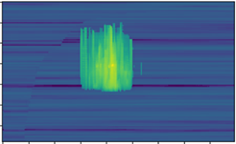
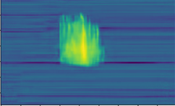
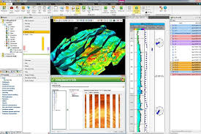
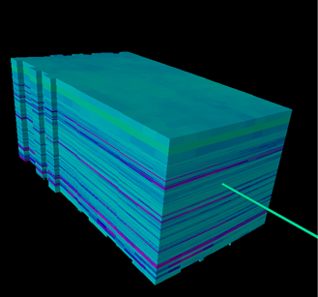

ALF workflows and architecture
AI training workflow
Azure ML Services
training data preparation
upload training data to cloud storage
AI training
publish trained AI as a service
physics guided neural network
AI training workflow
prediction workflow
prediction workflow
reservoir data preparation
upload reservoir data to cloud storage
AI prediction using service
download predicted data for visualization
Petrel Plug-in
Notes:
ALF Petrel plugin through deep learning algorithms (CVX proprietary NN model) and powerful could computing and Petrel I/O processing to quickly predict fracture geometry and high resolution post-frac permeability map ready for performance diagnostics and reservoir simulation.

Slide 6
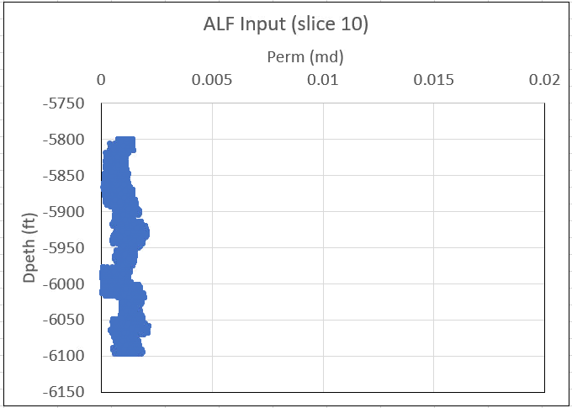
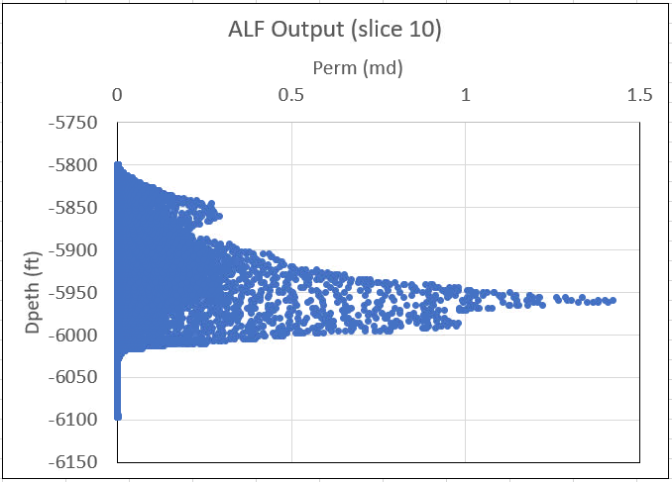
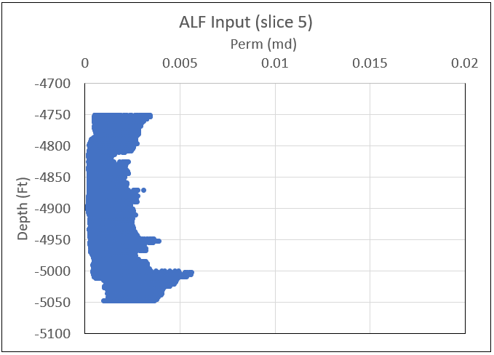
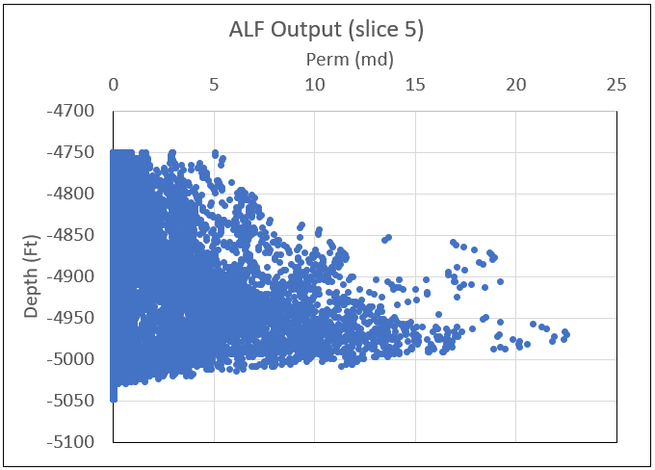
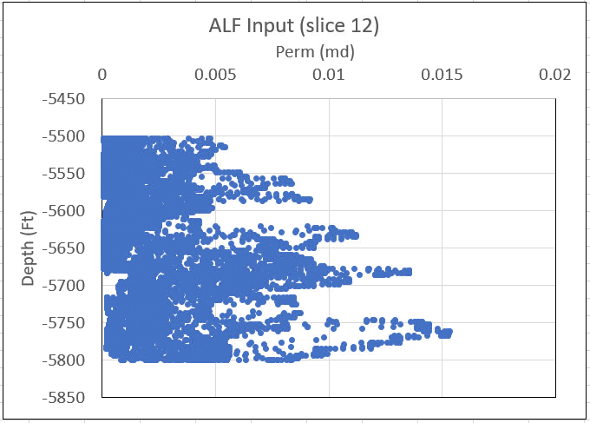
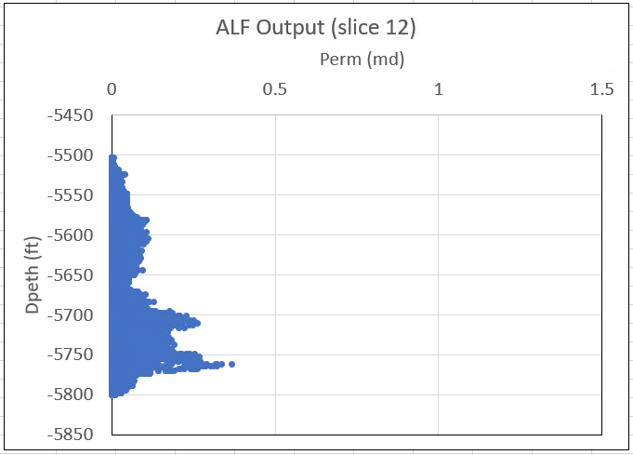
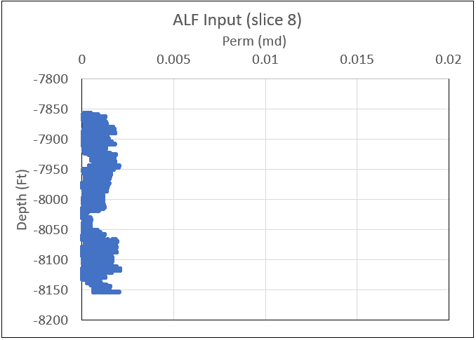
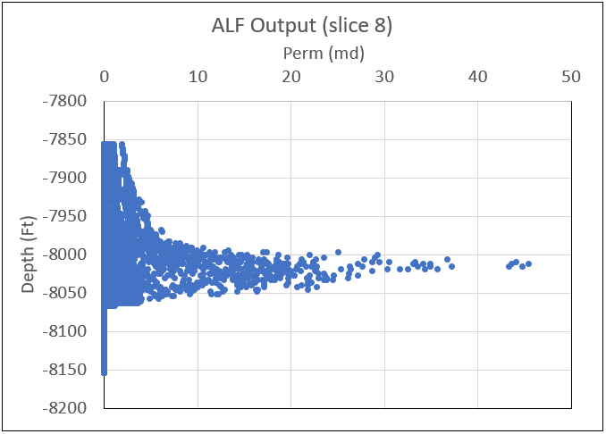
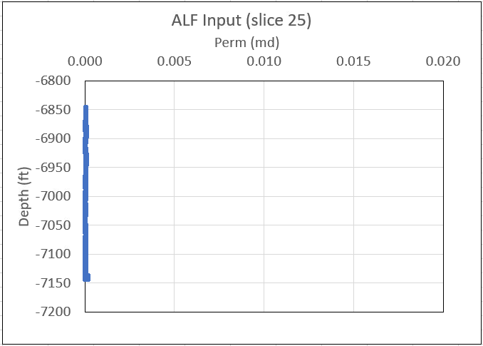
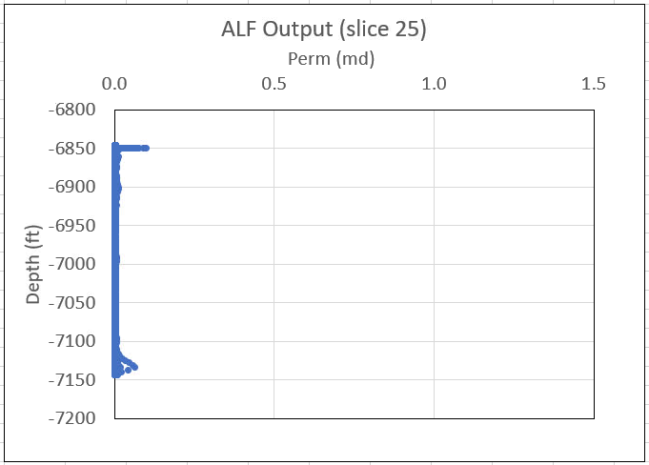
Field testing challenge: Different permeability range in different MCBU field datasets
HHTX Input Permeability
HHTX Output Permeability
Delaware Ranch Input Permeability
Delaware Ranch Output Permeability
Culberson JDA Input Permeability
Culberson JDA Output Permeability
Reeves Input Permeability
Reeves Output Permeability
Bradford Ranch Input Permeability
Bradford Ranch Output Permeability
After we started testing ALF at four development areas, we found that the training dataset had a narrow range.
Efforts were then taken to build a large training dataset with wider range of input parameters.
Notes:
It is easy for us to learning how to build a deep learning model using existing image dataset from Kaggle or Imagenet library. However when we deal with field case, there are different types of challenges you will face. Here you can see the data distribution in different MCBU fields are very different. We may spent weeks or months even years to build an deep learning model and achieive a very good accuracy or score in one field but the model may not be use in another field even they are neighborhood. We had this issues in MCBU.

Slide 7
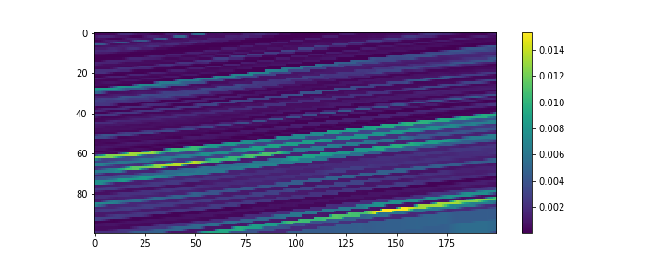
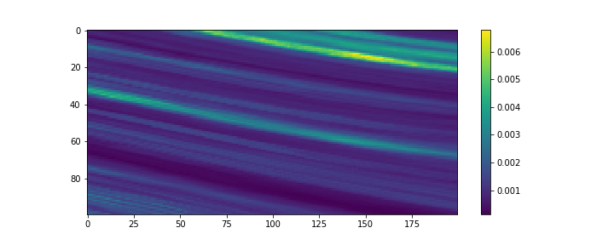
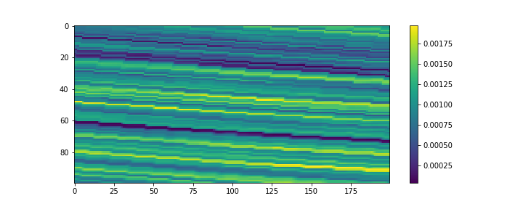
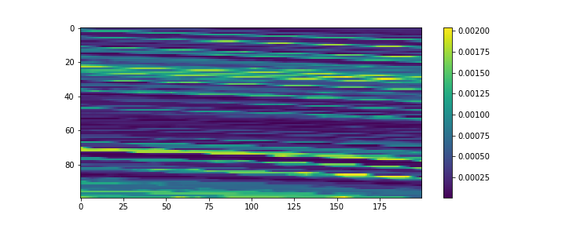
Four Models: California, Delaware Ranch, HHTX, Reeves (Intrinsic Permeability)
California Field
Delaware Ranch
HHTX
Reeves
Notes:
Look at how preliminuary permeability look like in different MCBU fields. They are very different. Jumputing, smoothing, different direction dipping. Variation ranges.

Slide 8
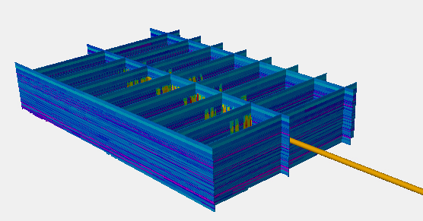
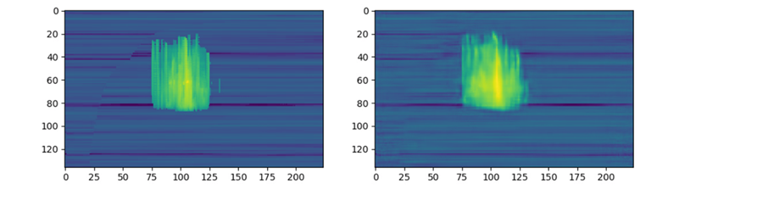
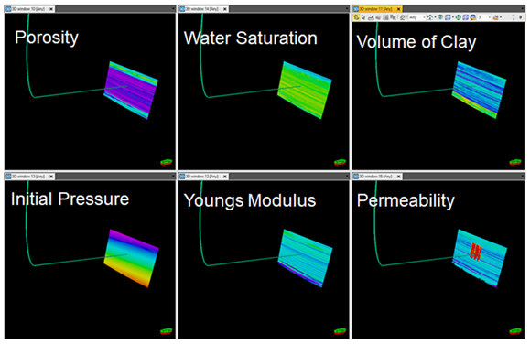
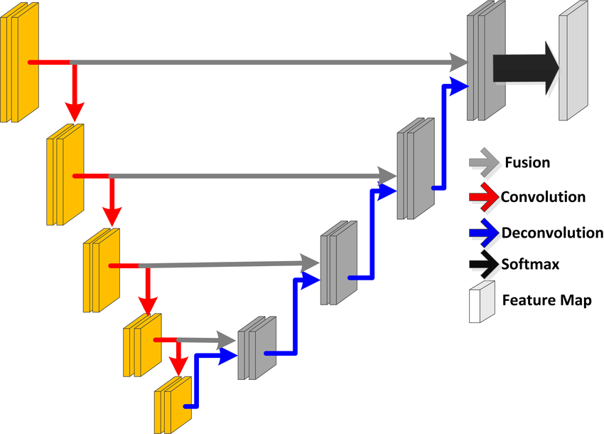

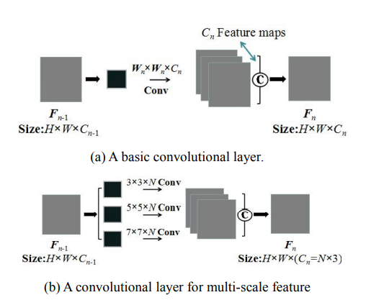
Solution: CVX proprietary physics-guided U-net model using Inception
Reservoir Grid
reference
AI prediction
Horizontal Well
cut
Input
Linear
Notes:
For this project, we design a CVX propriety physics-guided U-net model using Inception.
The invention is a new way to do physics-guided neural network for the subsurface reservoir characterization problem.
Firstly, our data set has been prepared through an integrated physical modeling workflow with earth modeling, hydraulic fracturing, performance prediction and uncertainty assessment and further validated through field production and surveillance in different areas and formations.
Secondly, the network architecture for deep learning is customized to deal with different scales in fractured- and non-fractured zones. It is not limited to a 1D or 2D dense network but can use different 2D or 3D convolutional neural networks, for example, UNet or Autoencoder models with residual like blocks or inception like blocks.
Thirdly, we innovated data ingestion by creating a super image set with multiple channels where each channel contains the specific 2D or 3D reservoir and rock properties and loading in batches for training and prediction.
Fourthly, the method discretizes input and output properties and also considers transformations to change variables from linear to logarithm or exponential on the basis of physics.
Finally, the method adds an extra loss function term for structural constraints to distinguish fractured and non-fractured zones where non-fractured zones retain as same as the original background and fracture zones are satisfied with local smoothing and considered by physical pattern continuities.

Slide 9
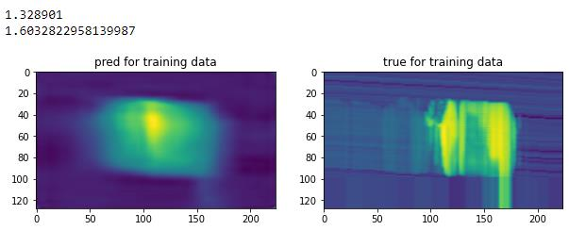
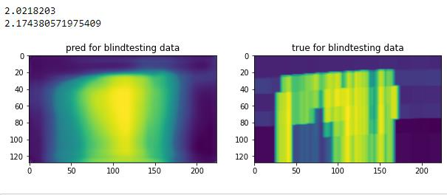
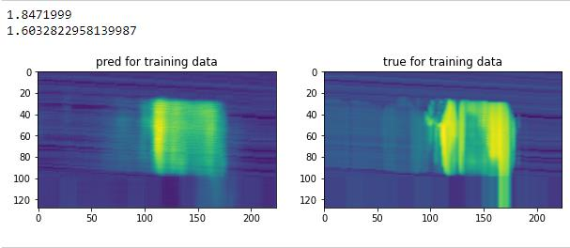
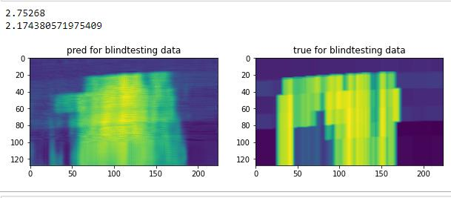
Training and blind testing for different datasets
Naïve Unet model
Naïve Unet model
CVX proprietary model
CVX proprietary model
Notes:
Here shows the comparison between AI result and results generated from simulators.
The top figures show naïve Unet model pure CNN, no skip connection, single convolution operator during propagation.
The bottom shows the result from CVX proprietary model.
The left are from HHTX field and the right from California field in MCBU.
In each frame, the left figure shows the AI result, the rights showsn the result from simulatros.

Slide 10
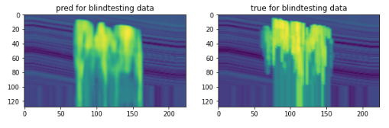
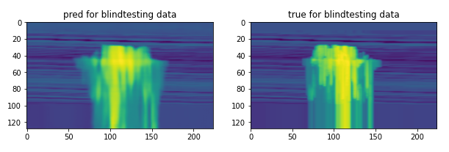
Recent Blind testing for new scenarios
Delaware Ranch
Reeves
CVX proprietary new Unet model ensures ALF to be powerful & generalizable to new fields in MCBU
Notes:
This is the recent blind testing for new secnarios. We have test 4 and 5 different MCBU fields. Our CVX proprietary new Unet model ensures ALF to be powerful & generalizable to new fields in MCBU

Slide 11
What I learn
Understanding 10 classic deep learning neural network architecture is a requirement if we want to design generalizable neural network for Deep learning type application.
AlexNet
VGG16
ResNet50
GoogleNet (Inception)
Xception
Hyperparameter tuning is very important to overcome overfitting
Notes:
This is what I learn slide.
1st, Understanding 10 classic deep learning neural network architecture is a requirement if we want to design generalizable neural network for Deep learning type application.
2nd Hyperparameter tuning is very important to overcome overfitting

Slide 12
What I do in Chevron? Proposed innovative idea to use Deep Learning Clustering for DAS Microseismic and completed PoC development successfully
Notes:
My 2nd project is Poc experiment, I collaborated with Lin Zhang form seismic imaging R&D. deep learning clustering to classify different DAS microseismic events.

Slide 13
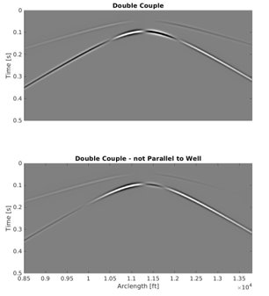
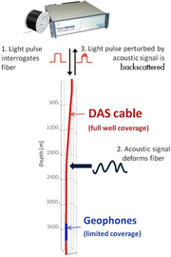

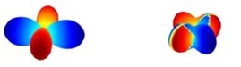
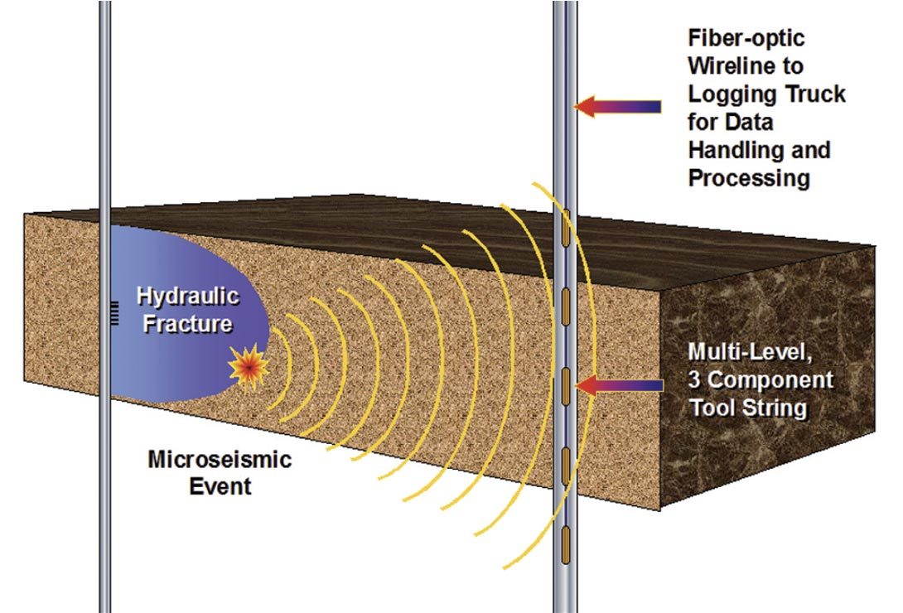
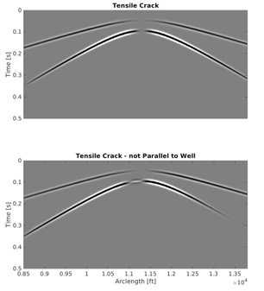
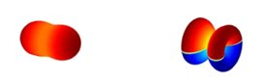
Deep Learning clustering for DAS Microseismic
Double Couple Sources​
3-C Geophone Recording System
DAS Recording System
3-C Geophones
Measure Strain or Strain Rate along Cable
Tensile Crack Sources
Treatment Well
Distributed acoustic sensing (DAS) provides many benefits for fracture monitoring but provide massive datasets which are expensive to process.
Notes:
Here a lof of you may be familiar with DAS means distributed acoustic sensing already.
It is used for unconventional.
We have two wells here. Left One is treatment well. Right one is observation well where the fiber is located.
We use hydraultic fracturing in treatment well To generate fractures which will induce microseismic signal to be captured by fiber sensors on the right well.
On the right, the two seismograms represents two different fracturing type.
The project I am working is to classifiy these events which can help to see what kind of fracture happen In subsurface which will play an important role for unconventional oil and gas production.

Slide 14
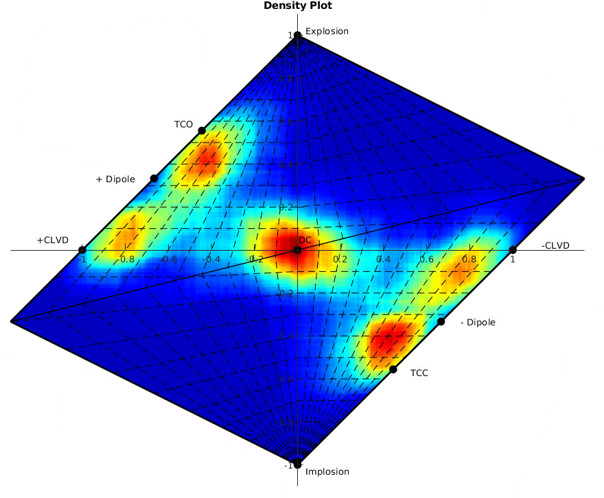
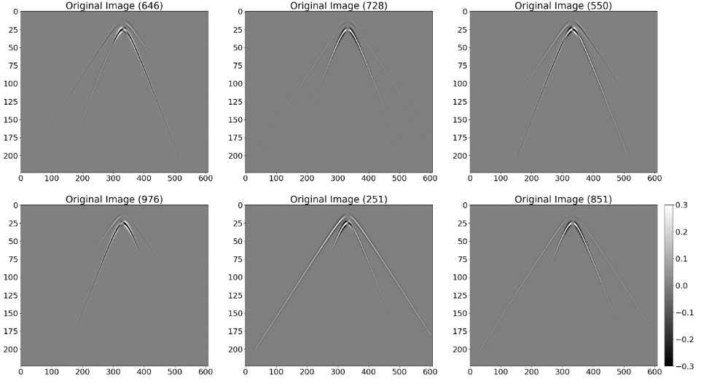
Test Dataset
1000 microseismic images (224x608 pixels) generated with analytic modeling tool.
Random moment tensors constrained by being CLVD, TC, or DC dominated.
Used as input into CAE
600 images for training; 400 images for validation
Notes:
This is the dataset we have 1000 datasets. Those datasets are generated using Random moment tensors constrained by being CLVD, TC, or DC dominated shown in right figure.
The left bottom shows the images.

Slide 15
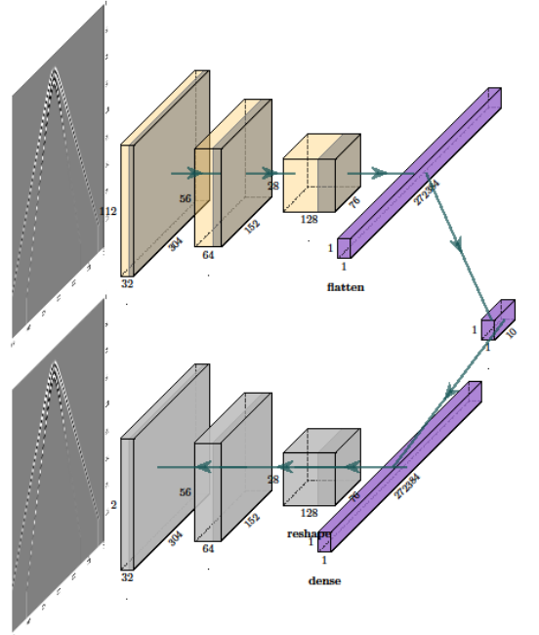
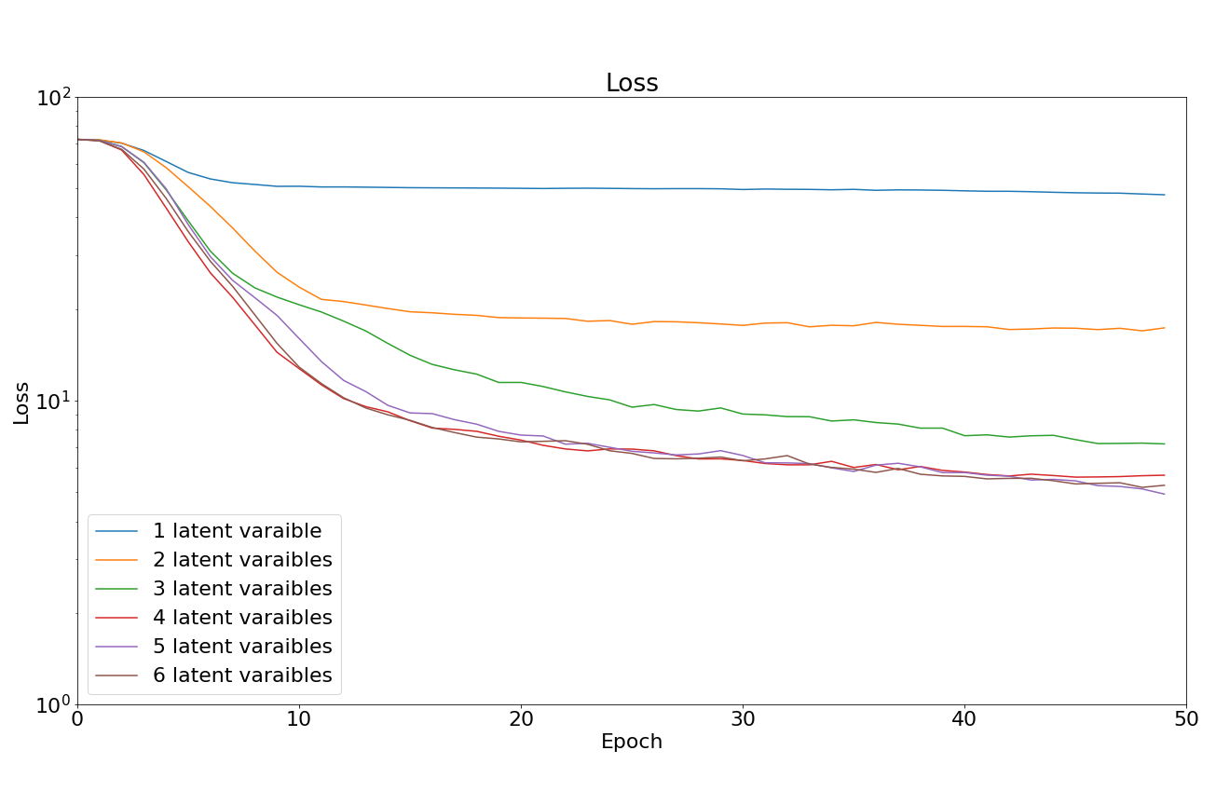
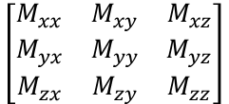
Latent Space Dimensionality
GOAL: Collapse input images to the fewest number of features required for successful image reconstruction.
$$\left[\begin{matrix}M_{xx} & M_{xy} & M_{xz} \\ M_{yx} & M_{yy} & M_{yz} \\ M_{zx} & M_{zy} & M_{zz}\end{matrix}\right]$$
6 unique components
5 latent features
Notes:
In this POC we used AutoEncode DL neural network architecture. On the top Images are encoded and represented by 1D vector in latent space.
After that those 1D vectors are sent to decoder to restore back the original images.
The key is how to represent these 2D seismograms into 1D vector in latent space using auto encoder NN without losing information.
Once we have 1D vector in latenet space,
Then we can go to use clustering methods like K-means, dbscan or other algorithms.
This is a classic 2 step workflow.

Slide 16
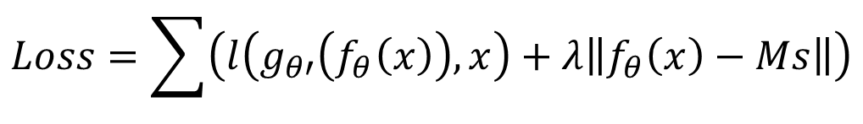
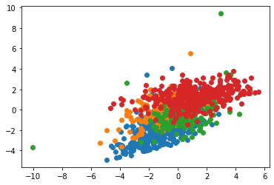
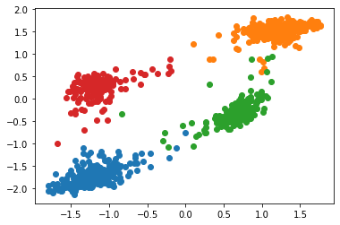
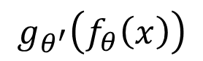

Deep Learning clustering for DAS microseismic
$$x$$
Reconstruction Error
Clustering Error
Clustering Error
$$f_{θ}\left(x\right)$$
Reconstruction Error
Baseline: 2 steps by clustering after reconstruction error only deep learning
Deep learning clustering using joint loss function
Train DNN model is not just separate data into train and test and fit in a model
Notes:
The conventional 2 steps results are shown on the first figure. Where most events are not separated very well.
On the right, we used a hybrid loss which include not only reconstruction error but also clustering error.
The results shows the clustering results has been improved a lot. The design of new network architecture
by using different loss function is very import for subsurface digital problem.

Slide 17

What I learn
Understand the training procedure of a deep learning and how to adapt it to include different domain knowledge in training is key for success.
Notes:
From this project, I learned, Understand the training procedure of a deep learning and how to adapt it to include different domain knowledge in training is key for success.

Slide 18
What I do in Chevron? Deep Reinforcement Learning for Field Development Plan Optimization as a full stack AI developer from backend DRL to frontend serverless computing
(patented)
Notes:
Next I want to introduce my 3rd project.

Slide 19

OilField Development Plan Optimization with AI
What are we doing?
Improve simulation based field development plans leveraging deep reinforcement learning and cloud computing
Why are we doing it?
Improve simulation based field development plans leveraging advances in deep reinforcement learning and cloud computing
Offline training stage: AI exploring different auto-generated scenarios and actions
Online application stage: Using AI to obtain optimized actions for a new scenario with minimal effort
Incorporating expert knowledge as rules to minimize unnecessary trials and accelerate training
Existing techniques does not learn from past optimization studies, and thus only provide limited optimization even with thousands of simulations
Supports step-change reduction in subsurface basis-of-design (SSBOD) cycle time and improved business decisions
Help understand potential of deep reinforcement learning techniques for subsurface and beyond
Optimize Development Planning and Execution
“Our Performance feedback loop helps operations optimize development plans from learnings on the fly”
Decision Driven Development Modeling
“I am able to intelligently identify and integrate the most important data that reduces forecast uncertainty and increases decision quality”
What has been done so far?
What are the next steps?
Project Manager
High-Performance implementation leveraging massive parallelization and high performance GPU on Azure cloud
Accelerated POC by adding additional OC and computational resource from Tech Computing
Successful POC on simplified 2D reservoirs, in which AI outperforms reference develop strategy over 95% of the time
Extend the method to handle realistic-sized reservoir with practical complexities (e.g. 3D, faults, uncertainties, horizontal wells, etc.)
Demonstrate “super-human” performance on the field development planning of a green field primary depletion with vertical wells
Jincong He (ETC,RPE)
Initial Team composition
ETC (RPE, TC)
Notes:
We use AI to do oil field development plan optimization.
Existing techniques does not learn from past optimization studies, and thus only provide limited optimization even with thousands of simulations
What ew are doing, 1st objective is to Improve simulation based field development plans leveraging deep reinforcement learning and cloud computing.
Offline training stage: AI exploring different auto-generated scenarios and actions
Online application stage: Using AI to obtain optimized actions for a new scenario with minimal effort
Incorporating expert knowledge as rules to minimize unnecessary trials and accelerate training
Two important Busines impact
Supports step-change reduction in subsurface basis-of-design (SSBOD) cycle time and improved business decisions
Help understand hwo to use potential of deep reinforcement learning techniques for subsurface and beyond in cVX, for example, we have a very good collaboration with MSFT wand we push them to deploty distributed computing Ray cluster framework in AzuremL as two of top collborators with MSFT. We sharing our learning and codes with MSFT to ensure their DRL in azure.

Slide 20


Training the AI as a Deep Neural Network
Input: A stack of input channels; Output: Probability of drilling at any location(or not drill)
Network is trained using a large number of simulations
Notes:
Along with supervised learning and unsupervised learning, Reinforcement Learning (RL) is one the three basic machine learning paradigms.
Reinforcement Learning is different from supervised and unsupervised learning in part because it is learning from interaction.
RL is concerned with finding the best course of action someone, or something, can take at a particular point in time in order to achieve a goal. The difference between them is that deep learning is learning from a training set and then applying that learning to a new data set,
while dataset samples for reinforcement learning are from simulation. In order to ensure good learning, we need enough samples generated, that means we need a lot of simulations, millions of simulations.
Applying the discipline to complex scenarios can lead to computational challenges both in terms of learning stability and long training times. These can prevent effective deployment in time-sensitive applications.

Slide 21




Proof-of-Concept Study
PoC on synthetic models for primary depletion planning (trained on 2MM+ models)
Input: Permeability field; Output: Development plan (well count/location/sequence)
Once trained, AI solution beats the reference (optimized pattern drilling) 98% of the time
Pattern driller
AI driller

Slide 22


1st Practical FDP DRL Application to GOM Asset
AI
Baseline

Slide 23





Mlops using serverless computing and Realtime AKS pipelines
AI and engineers
Field development plan
Notes:
In the end, I want to share MLOps, we have a project to use deep reforcement learning to do field plan optimization. That is given a oil field, we want to know wehre we should drill wells and how many wells we should drill in order to get the maximum profits. An AI, after being trained on a large number of synthetic reservoirs, provideds optimized development plan for a new reservoir without any simulation. Optimization cycle time could be reduced from weeks to hours and Here you can see AI solutions can beat the reference(optimized pattern drilling) 98% of the time.
We not only developed DRL solution for field plan optimization, we also use ML Ops to deploy it. This is the first digital solution on Azure to use MLOps for deep reinforment learning delivery.
we used serveless computing, hierarchy pipelines with Azure Data factory and Azure ML workspace plus ray cluster technologies to ensure the success.

Slide 24
What I learn
It is very important to understanding what is Reinforcement learning (Deep learning + Simulation under Markov Decision Process) and more important is to get familiar with how to use it for subsurface problem.
It is impossible to have a success DRL without understanding how to implement in Distributed computing platform.
MLOps and cloud computing is a must.

